Slide 1
Introduction
Provider : Hamzeh Pirvand
Lesson : Neural Network
Topic : CNN
Fall 2021

Slide 2
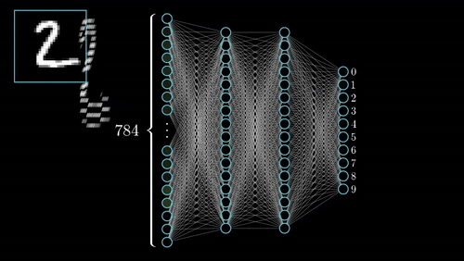
Feed-Forward Neural Network

Slide 3
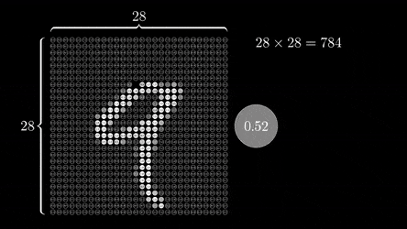
Input Features

Slide 4
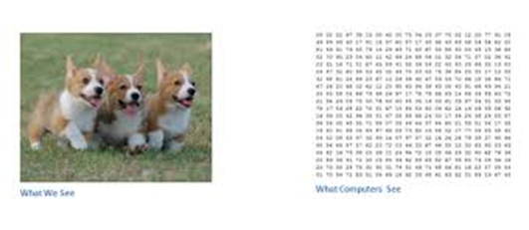
Convolutional Neural Network

Slide 5

Input is image

Slide 6
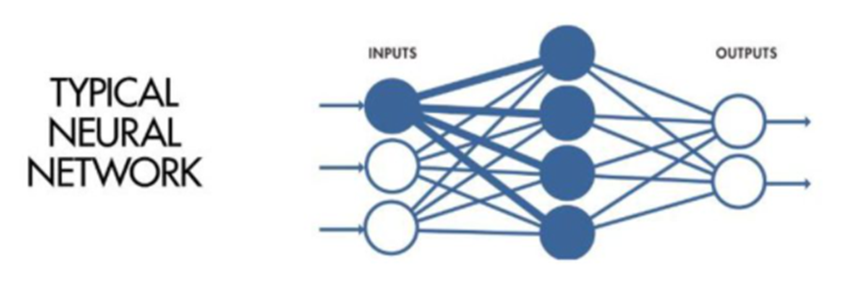
ConvNets vs Regular-NN
Local Receptive Field

Slide 7
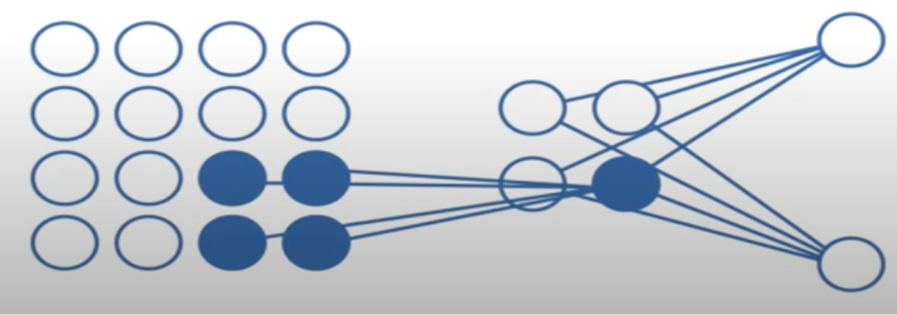
ConvNets vs Regular-NN

Slide 8
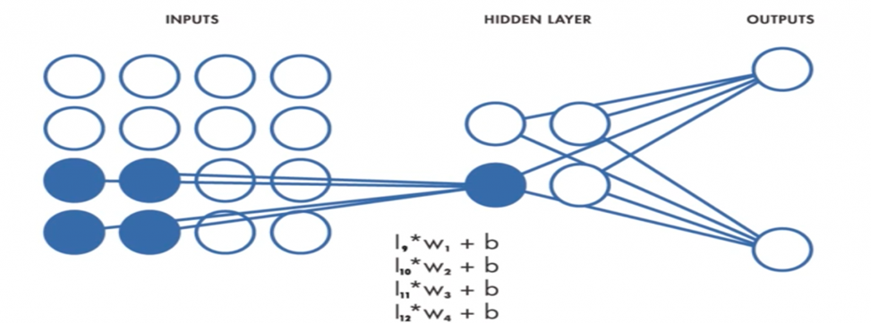
ConvNets vs Regular-NN
Shared Weights and Biases

Slide 9
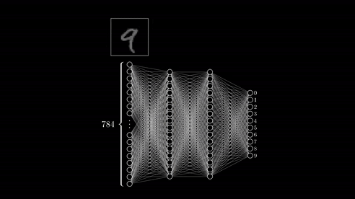
ConvNets-Feature-Learning

Slide 10
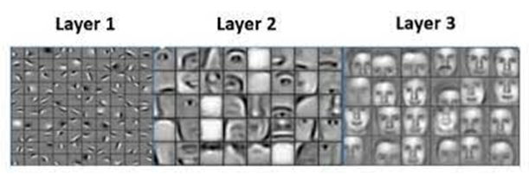
ConvNets-Feature-Learning

Slide 11
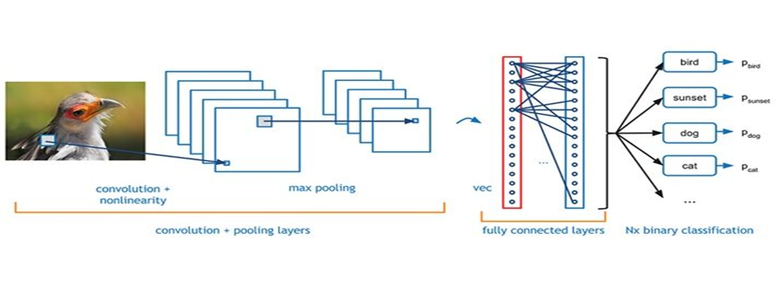
Convolutional Neural Network Architecture

Slide 12
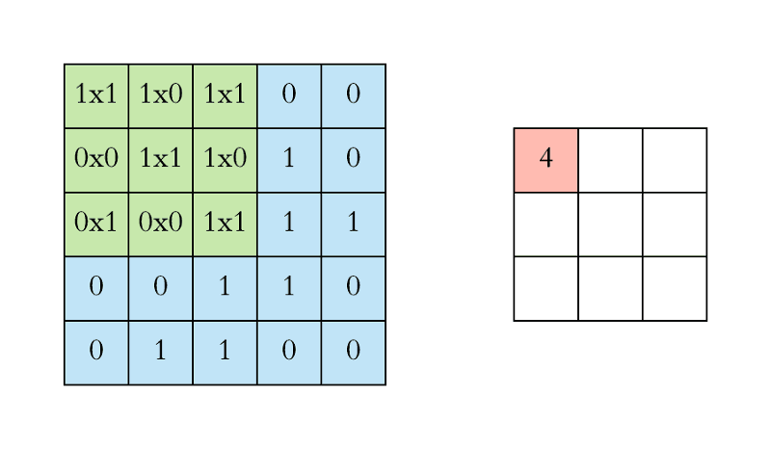
Convolutional Layer

Slide 13
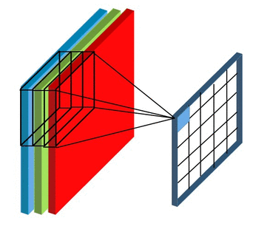
Convolutional Layer

Slide 14
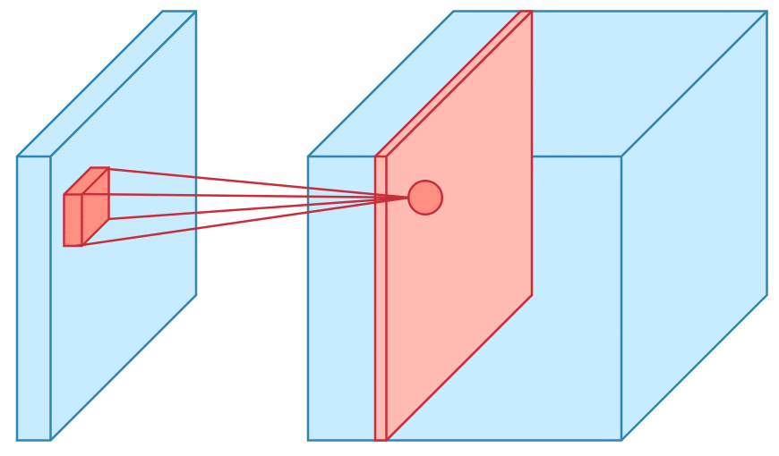
Convolutional Layer

Slide 15
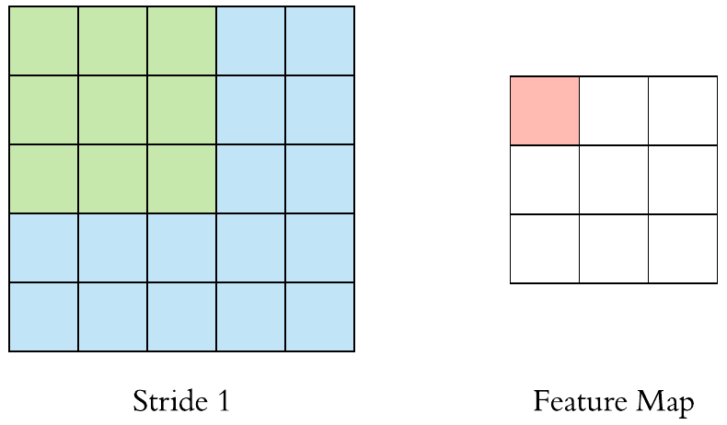
Stride

Slide 16
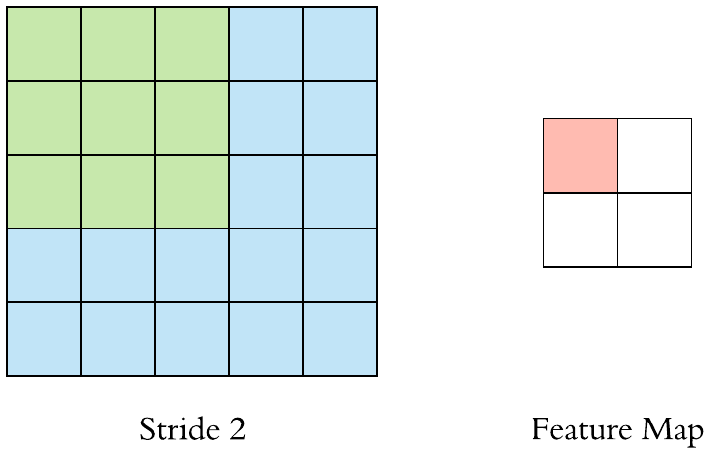
Stride

Slide 17
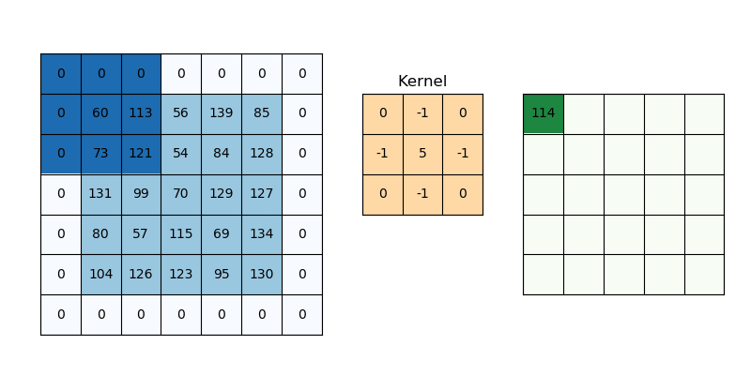
Padding

Slide 18

Max Pooling Layer

Slide 19
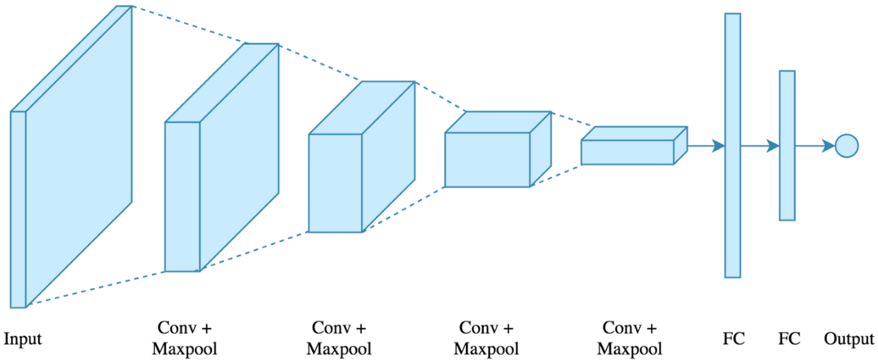
Fully connected Layer

Slide 20
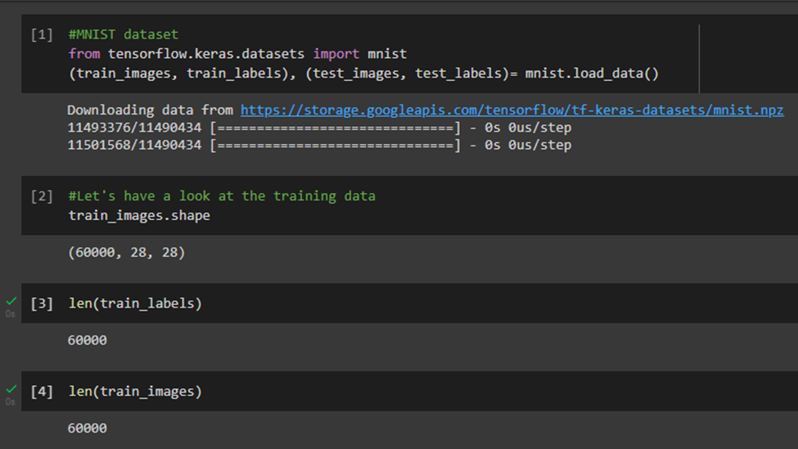
A first look at a neural network

Slide 21
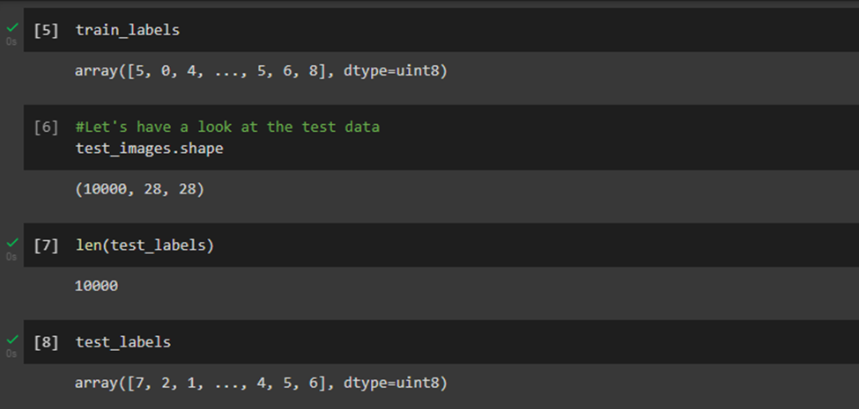

Slide 22
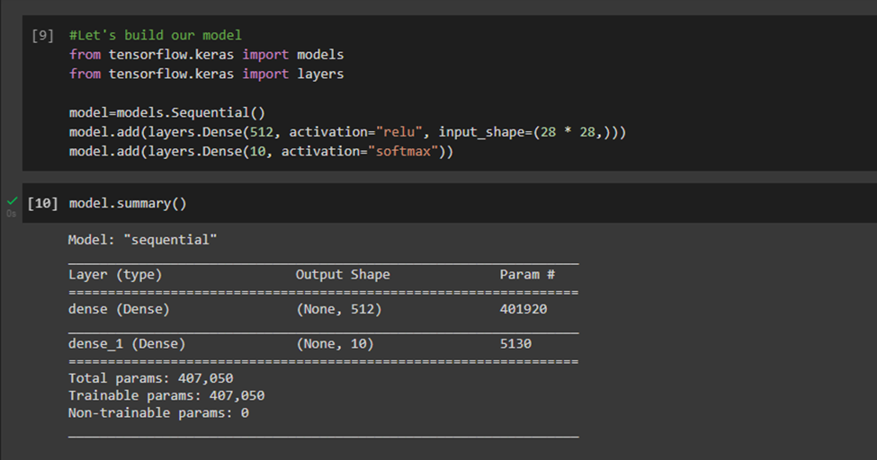

Slide 23
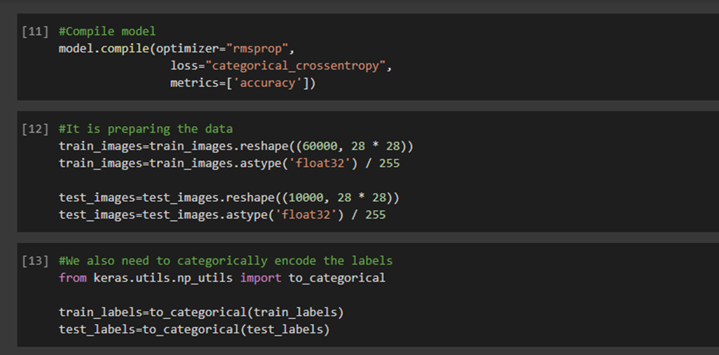

Slide 24
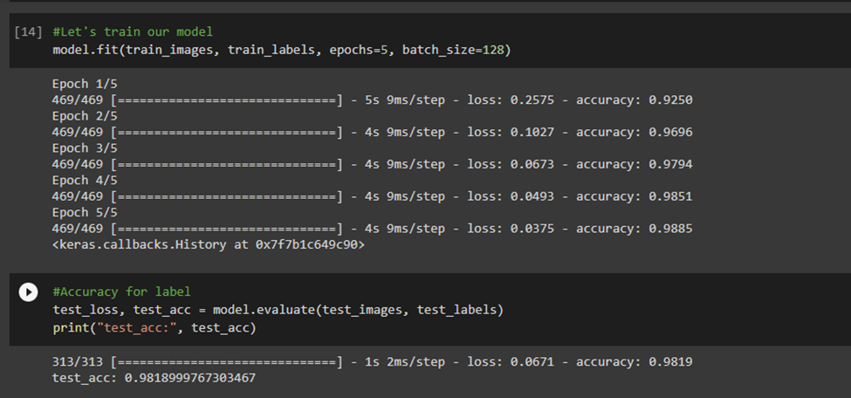

Slide 25
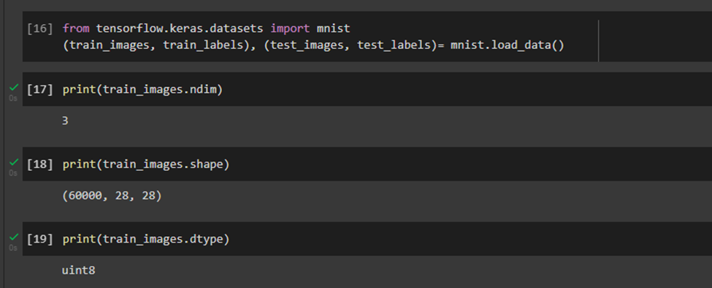

Slide 26
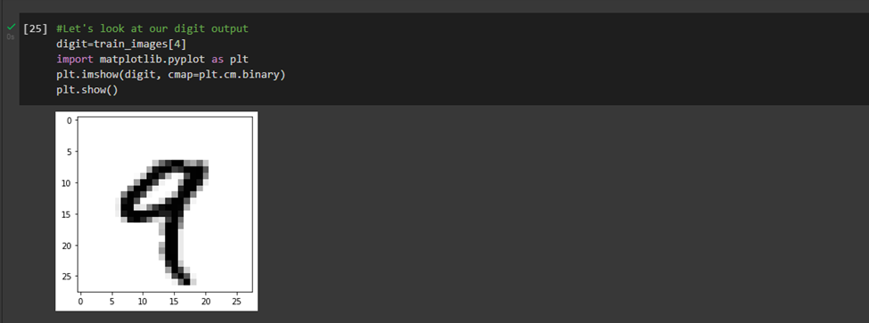

Slide 27
References
https://ieeexplore.ieee.org/document/8308186
https://arxiv.org/pdf/1512.07108.pdf%C3%A3%E2%82%AC%E2%80%9A
https://lamiae-hana.medium.com/an-intro-to-convolutional-neural-networks-cnn-9f1c2d888fa1
https://www.geeksforgeeks.org/applying-convolutional-neural-network-on-mnist-dataset/
https://en.wikipedia.org/wiki/Convolutional_neural_network

